Slide 1
Bayes’ Decision Theory and it’s Practical Implementation on Satellite Images

Slide 2
How to Implement
Four satellite Images of Kolkata (Rband, Gband, Bband and Iband) are given to you with equal image size (512 * 512).
The feature vector dimension is 4
Each pixel location we have four values.
Two Classes are given (River and NonRiver)
Take 50 sample points (Pixel location’s corresponding pixel values) from river class for training of each band
Take 100 sample points (Pixel location’s corresponding pixel values) from non river class for training of each band.
Take (512 * 512) sample points (Pixel location’s corresponding pixel values) for testing for each band.
Apply Bayesian decision rule to classify all the test sample either in river or nonriver class denoting 0 and 255 at corresponding pixel locations.
Show the result in image form with black and white image (either 0 and 255)

Slide 3
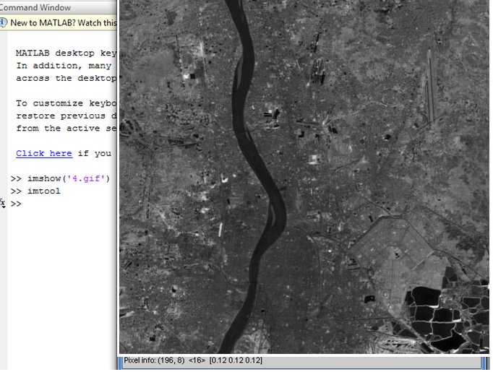
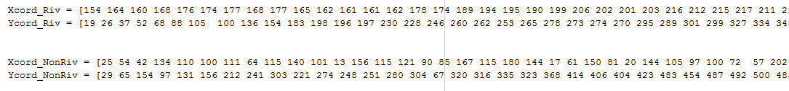
How to choose Training sample points

Slide 4
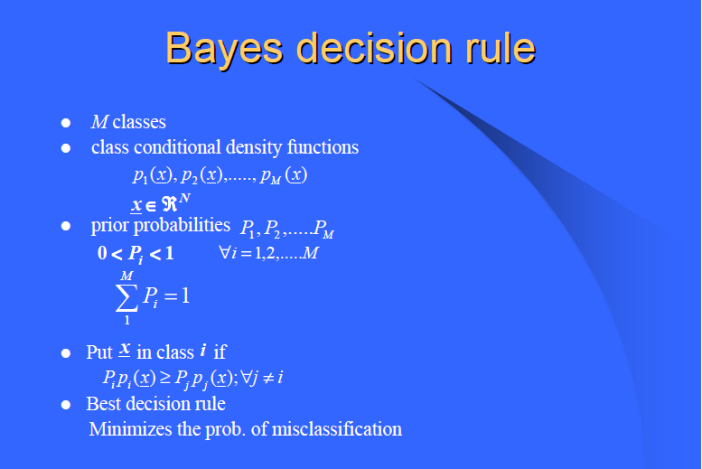

Slide 5
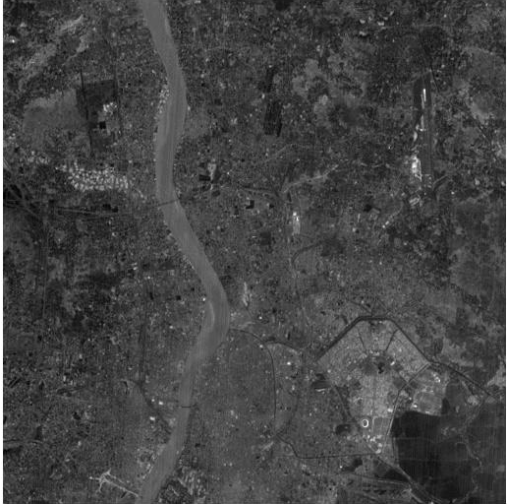
Examples on Satellite images of Kolkata: Given Input Images
R Band Image
(512 * 512)

Slide 6
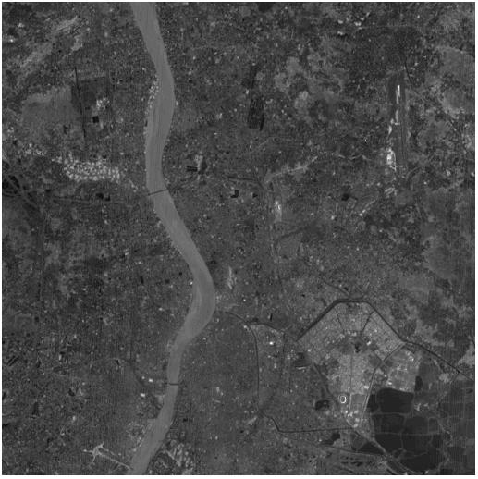
G Band Image
(512 * 512)

Slide 7
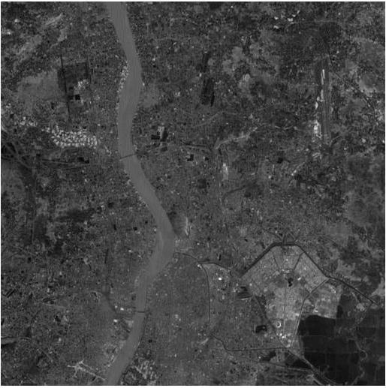
B Band Image
(512 * 512)

Slide 8
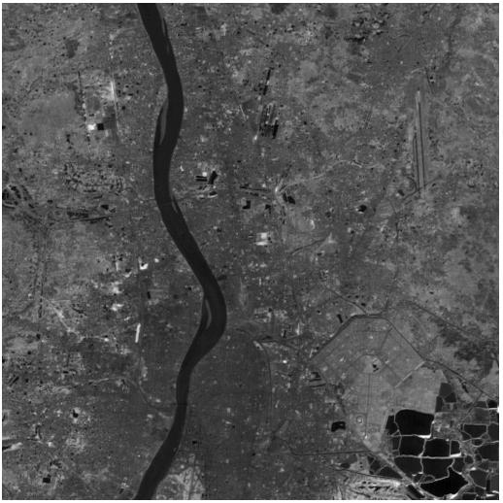
I Band Image
(512 * 512)

Slide 9
Bayes Rule: P1 = 0.3 and P2 = 0.7
Output Image (River Class and Non River Class

Slide 10
Bayes Rule: P1 = 0.7 and P2 = 0.3

Slide 11
Bayes Rule: P1 = 0.5 and P2 = 0.5

Slide 12
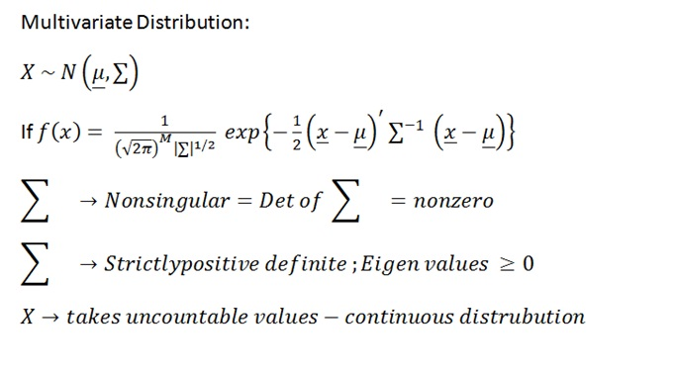
Multivariate Normal Distribution

Slide 13
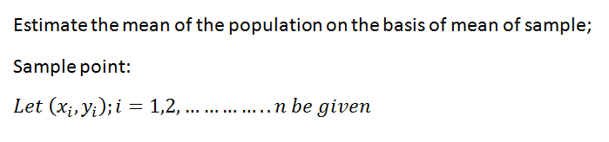
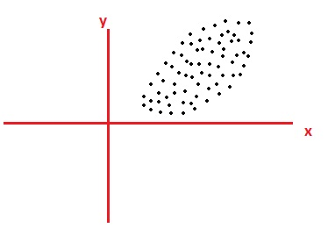
Concept of Covariance
Relationship of x and y on the basis of sample points

Slide 14
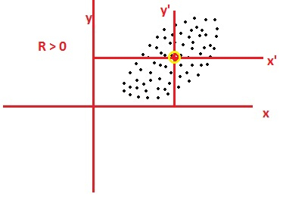
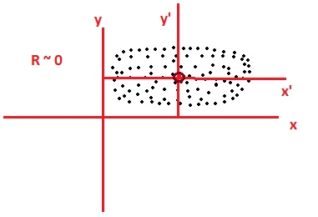
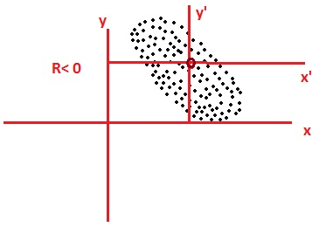
Positive Relationship
Here R denotes the relationship between two variables on the basis of sample points:
Case 1
Negative Relationship
Equally Distributed Relationship
Case 2
Case 3

Slide 15
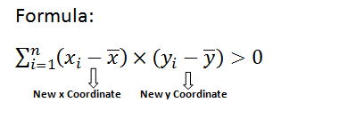
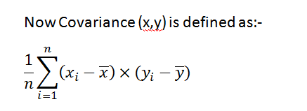
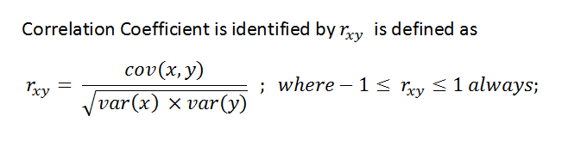

Slide 16
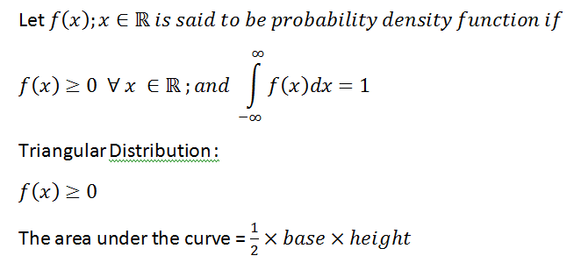
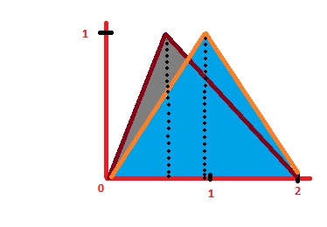
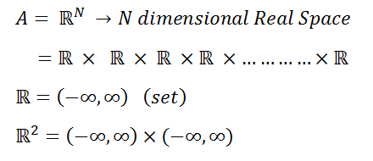
Probability Density Function

Slide 17
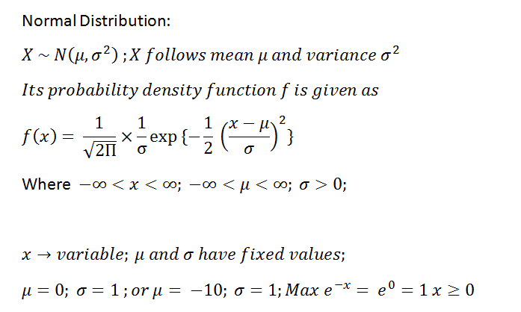
Normal Distribution
Stat Book: C. R. Rao: Linear Statistical Inference and its Applications

Slide 18
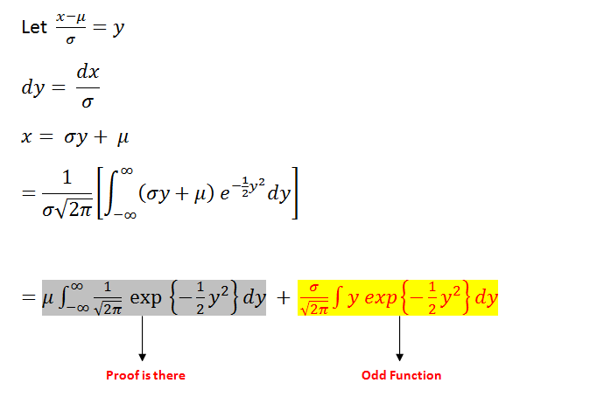
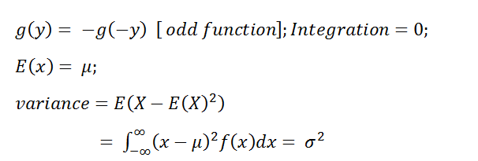

Slide 19
Implementation process of Density Function
Step 1: Calculate Mean of River Class : T1 = [Mean1; Mean2; Mean3 ;Mean4];
Mean1 = mean of Rband image for 50 sample points
Mean2 = mean of Gband Image for 50 sample points
Mean3 = mean of Bband image for 50 sample points
Mean4 = mean of Iband image for 50 sample points
Step 2: Calculate Mean of NonRiver Class : T2 = [Mean1; Mean2; Mean3; Mean4];
Mean1 = mean of Rband image for 100 sample points
Mean2 = mean of Gband Image for 100 sample points
Mean3 = mean of Bband image for 100 sample points
Mean4 = mean of Iband image for 100 sample points
Step 3: Calculate the Covariance Matrix for River Class for 50 samples which is 4 * 4 dimensions. Basically (X – T1) deviation and (Y – T1) deviation and multiply it and summing up
where X and Y represents all the sample points considered for training ( R, G, B and I band image) we will get 2^4 = 16 values in the covariance matrix for possible combinations of 4 band images. We are doing the deviation of sample points from the mean vector.
(Apply covariance matrix calculation formula)

Slide 20
Step 4: Calculate the Covariance Matrix for Non River Class for 100 samples which is 4 * 4 dimensions also by applying same process explained in step 3.
Step 5: Take whole image for test data where : test_data= [Rband_img(i,j) Gband_img(i,j) Bband_img(i,j) Iband_img(i,j)]; i = 1 to 512; and j = 1 to 512;
step 6: The dimension of test data is (4 * (512 * 512));
Step 7: For each pixel location of test image Run the loop from i = 1 to (512*512) Do
Step 8: For river class calculate (test_data – T1) deviation and (test_data – T1)^{T} Then Multiply it :
River_class = (-0.5) *(Test_data – T1)^{T} * Inverse (Covariance_matrix_Riverclass) *(Test_data – T1)
Step 9: For Non_river class calculate (test_data – T2) deviation and (test_data – T2)^{T} Then Multiply it :
Nonriver class = (-0.5) * (Test_data – T2)^{T} * Inverse (Covariance_matrix_NonRiverclass) *(Test_data – T2)

Slide 21
Step 10: Calculate density function p1 for river class where P1 = 0.3 given
p1 = 1/sqrt( Determinant of Covariance_matrix_Riverclass) * exp(River_class);
(Here we apply multivariate Normal Distrubution)
Step 11: Calculate density function p2 for nonriver class where P2 = 0.7 given
p2 = 1/sqrt( Determinant of Covariance_matrix_nonRiverclass) * exp(NonRiver_class);
Step 12: For each pixel location of test image apply baye’s rule (P1 * p1) >= (P2 * p2) then
Out_image(i) = 255 (River class)
Else
Out_image(i) = 0; (Nonriver class)
Step 13 : Goto step 7;
Step 14: Show the three output image Image using imshow function for three cases:
Case 1 : River class (Prior Prob: ) = 0.3 , Nonriver class(Prior Prob) = 0.7
Case 2 : River class (Prior Prob: ) = 0.7 , Nonriver class(Prior Prob) = 0.3
Case 3 : River class (Prior Prob: ) = 0.5 , Nonriver class(Prior Prob) = 0.5

